Slide 1
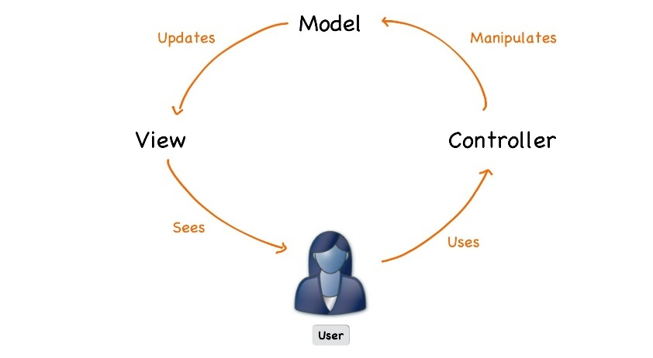



ASP.NET Core
Course Introduction
SoftUni Team
Technical Trainers
Software University
http://softuni.bg

Slide 2
Table of Content
Course Objectives
Training and Team
Course Organization
Course Infrastructure
Evaluation Criteria
Resources

Slide 3
Questions
sli.do #csharp-web

Slide 4

Course Objectives

Slide 5
ASP.NET Core Course Content (1)
Essentials of ASP.NET Core
Razor View Engine
Application Flow, Filters and Middleware
Web API
Security and Identity
Unit Testing
Project Architecture
ML.NET

Slide 6
ASP.NET Core Course Content (2)
SignalR
Azure, Deployment and Continuous Integration
Blazor
Razor Pages

Slide 7
Exam - Project Defense
Implementing a web application with:
.Net Core 2.2
Public defense of its work in front of a trainer
10 – 15 minutes
Demonstrate how the app works (very short)
Show the source code and explain how it works
Answer questions related to the project

Slide 8


The Module Team

Slide 9
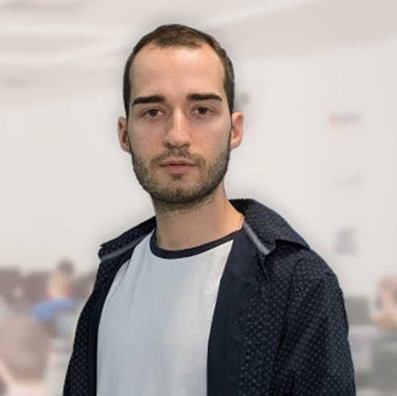
Module Team (Trainers)
Nikolay Kostov
Solutions Architect @ ZenCodeo
15+ years in the IT
Developer, Manager, Trainer, Architect
Аctive role in the development of the Judge platform - https://judge.softuni.bg/
Microsoft Certified Trainer
Personal blog: nikolay.it

Slide 10
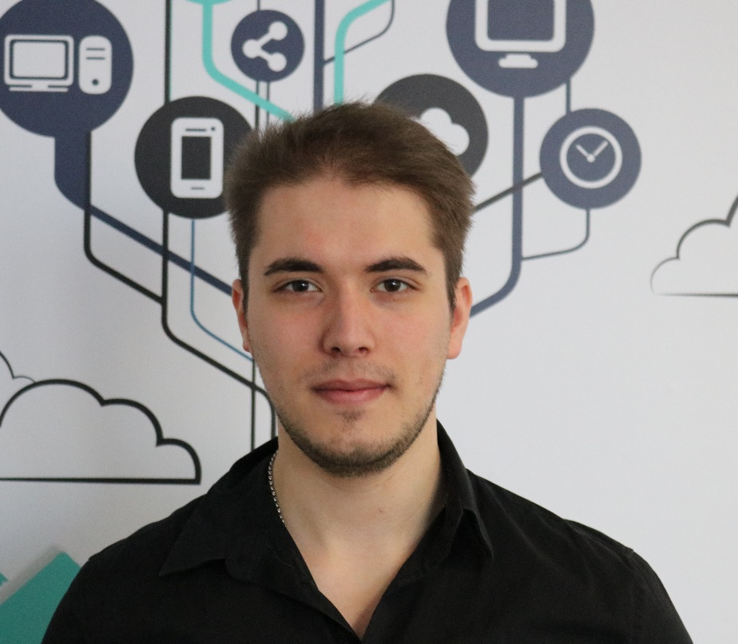
Module Team (Trainers)
Ivaylo Jelev
Training Team Leader @ SoftUni
5+ years in the IT
3+ years as a Technical Trainer @ SoftUni
Professional Problem Creator (Exam & Exercise Problems)
Interested in Game Development

Slide 11

Course Organization

Slide 12
ASP.NET Core Course at SoftUni – Timeline
17-June-2019
11-August-2019
15-August-2019
ASP.NET Core
7 weeks * 4 times / week
18 credits
Start: 17-June-2019
Project Defense: 11-August-2019
Project Defense: 15-September-2019

Slide 13

Homework Assignments & Exercises
Your homework is mainly work in class
Lesson days → slides + live demos + exercises
Exercise days → only exercises
Do your homework when it's due
Assignments pile up quickly

Slide 14


Scoring System for the Course
Mandatory:
Project Defense – 100%
Bonuses:
Presence in class – 5% bonus

Slide 15



Course Web Site, Forum and FB Group
Official web site:
Official discussion forum:
Official Facebook groups:
https://softuni.bg/trainings/2354/aspnet-core-july-2019
https://softuni.bg/forum/categories/31/csharp-mvc-frameworks-asp-net
https://www.facebook.com/groups/CSharpWebMay2019/

Slide 16

Resources
Resources
What We Need Additionally?

Slide 17


Required Software
Software needed for this course:
Microsoft Windows (Win 10 / 8.1 / Win8 / Win7) or Mac or Linux
Visual Studio 2019

Slide 18
Learn to Search in Internet & Find Solutions
The course assignments require to search in Internet
This is an important part of the learning process
Some exercises intentionally have no hints
Learn to find solutions!
Software development includes everyday searching and learning!
No excuses, just learn to study!
Developers learn new technologies, tools, languages every day!

Slide 19
https://softuni.bg/trainings/courses

Slide 20












SoftUni Diamond Partners

Slide 21




SoftUni Organizational Partners

Slide 22




Trainings @ Software University (SoftUni)
Software University – High-Quality Education and Employment Opportunities
softuni.bg
Software University Foundation
http://softuni.foundation/
Software University @ Facebook
facebook.com/SoftwareUniversity
Software University Forums
forum.softuni.bg

Slide 23

License
This course (slides, examples, demos, videos, homework, etc.) is licensed under the "Creative Commons Attribution-NonCommercial-ShareAlike 4.0 International" license

